Slide 1
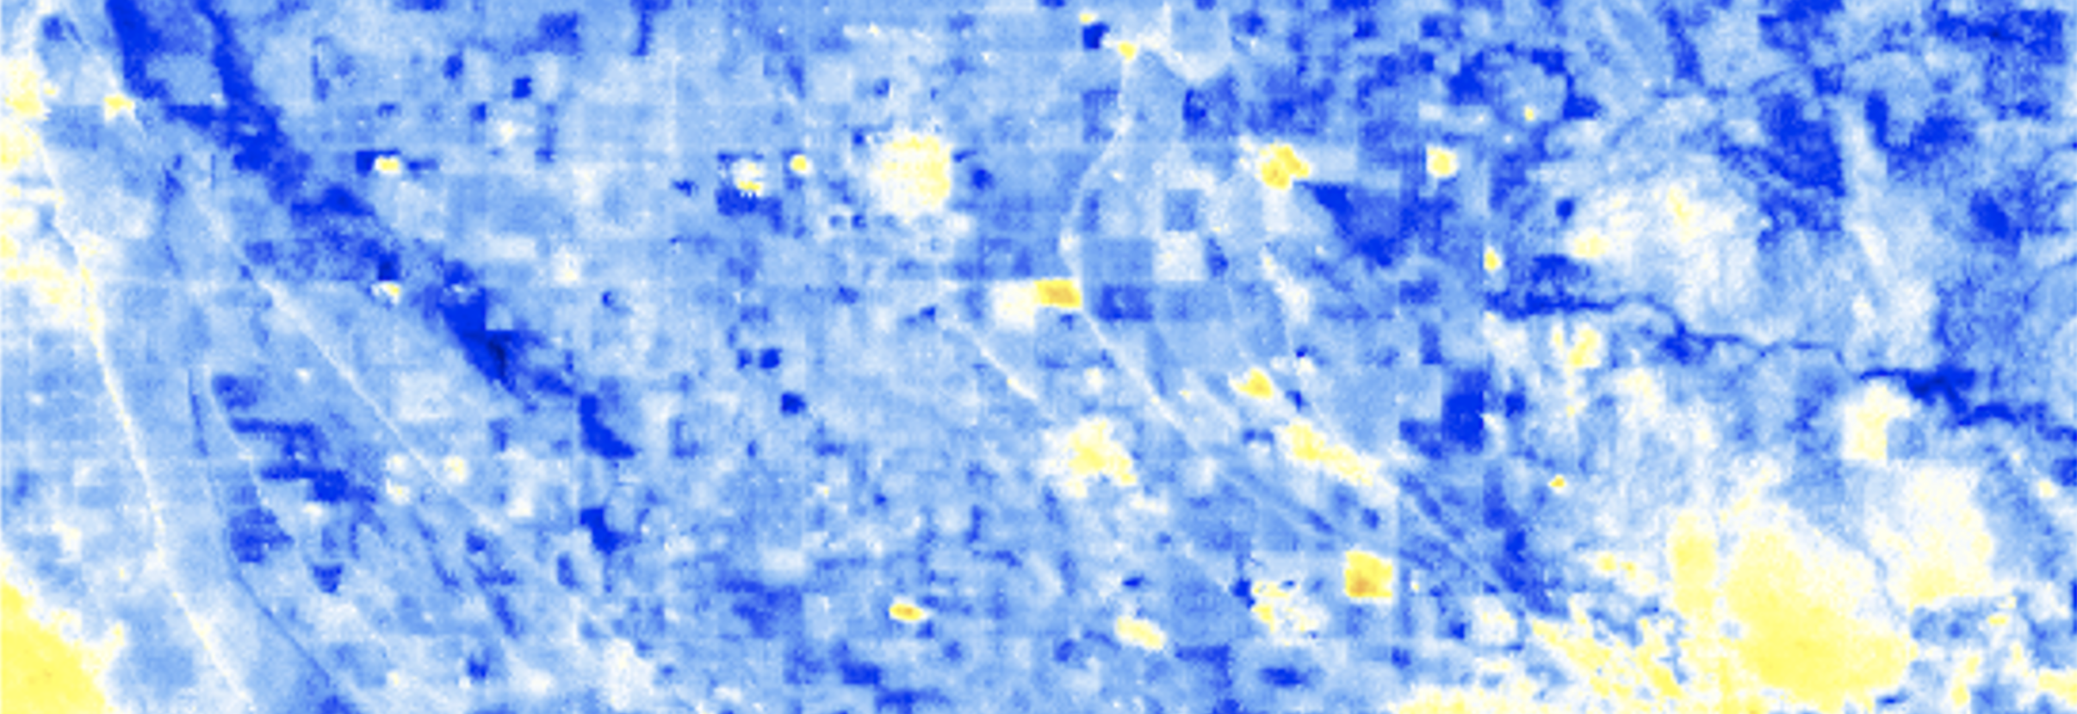
West Nile virus risk mapping using satellite derived temperature data
Anna Boser
Daniel Sousa
Ashley Larsen
Andrew MacDonald

Slide 2
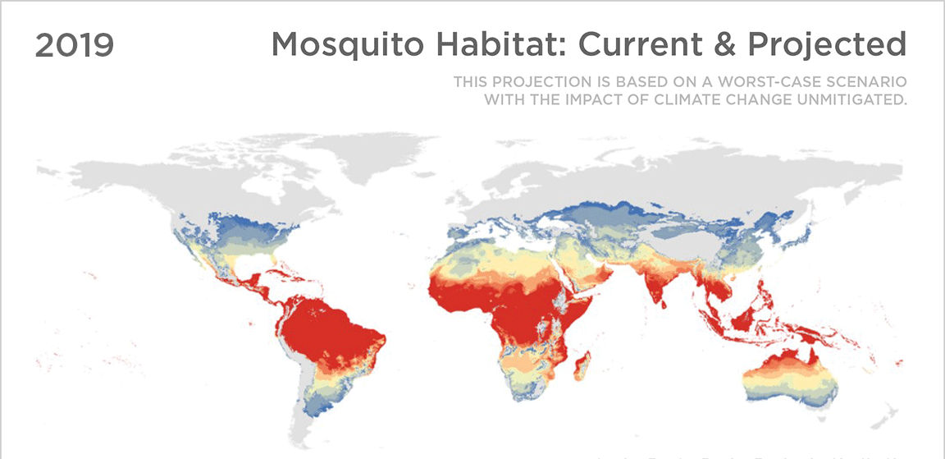
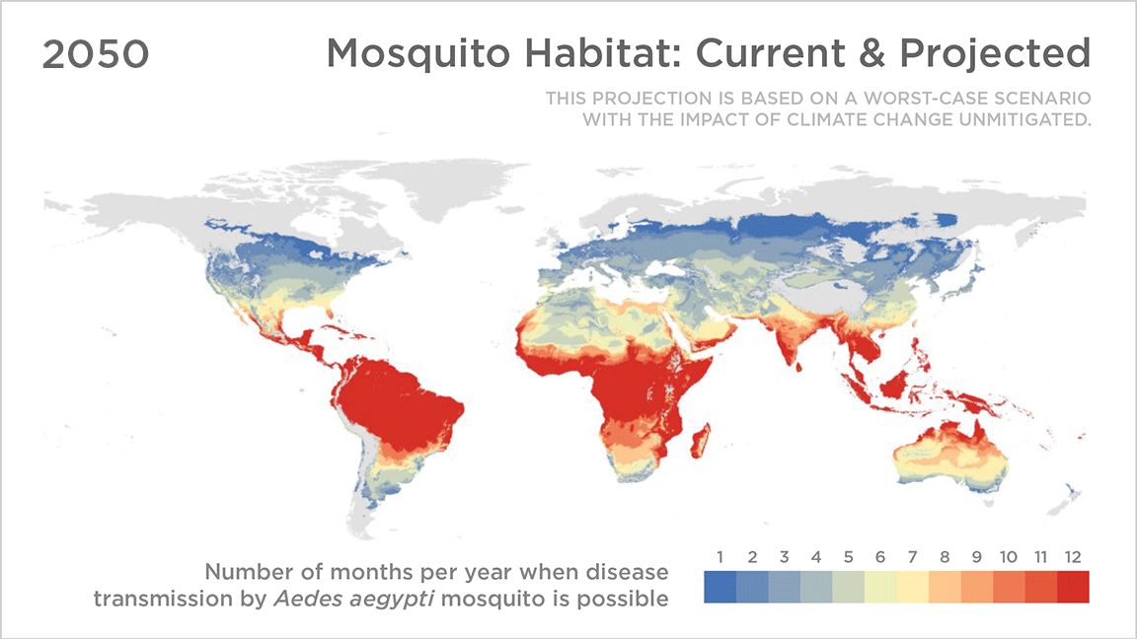
Mosquito-borne disease: Yikes!
Mosquito-borne diseases threaten 80%+ of the world’s population
Temperature is the greatest abiotic driver of West Nile virus risk
Risk maps are often:
Coarse in space and time
Unable to unpack the different contributors to risk
Introduction
Conclusion
Methods
Analysis
Source: Sadie J. Ryan, Colin J. Carlson, Erin A. Mordecai, and Leah R. Johnson
Credit: Koko Nakajima/NPR

Slide 3
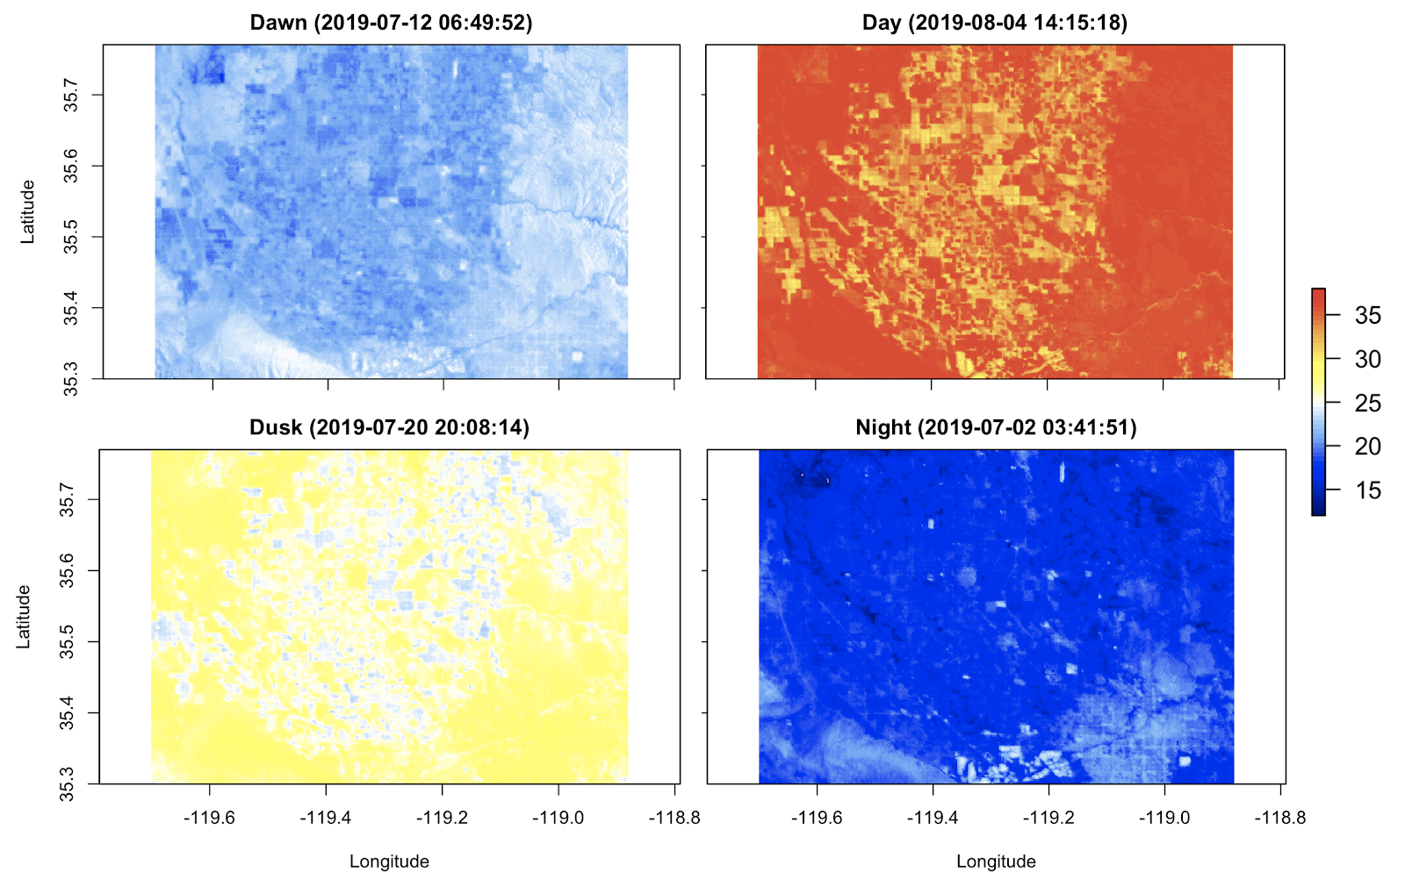
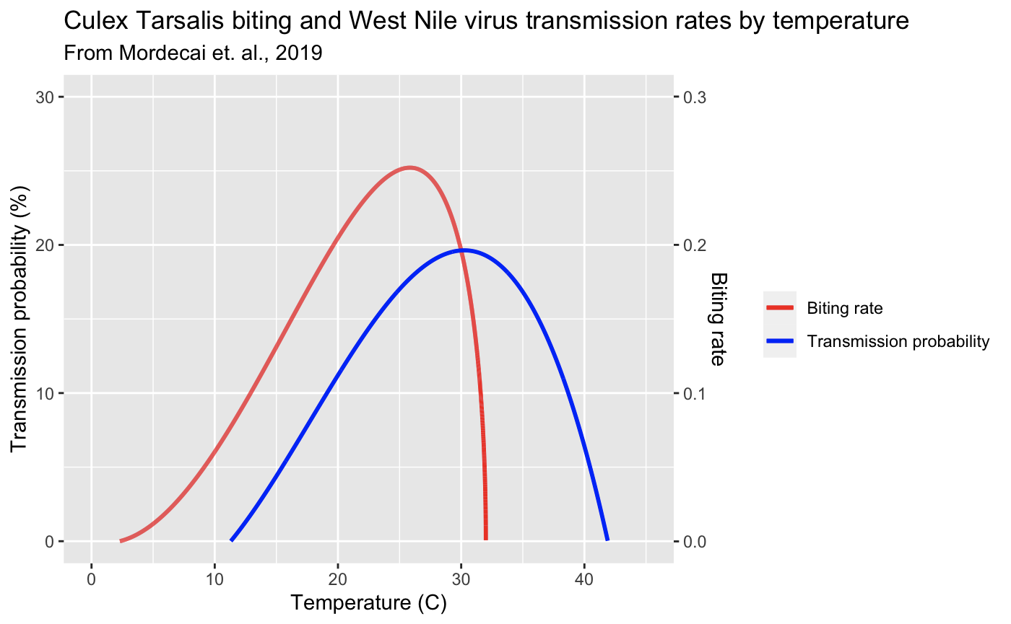
Making fine resolution risk maps
Temperature-risk relationships
Air temperature maps
Fine resolution risk maps
Introduction
Conclusion
Methods
Analysis

Slide 4
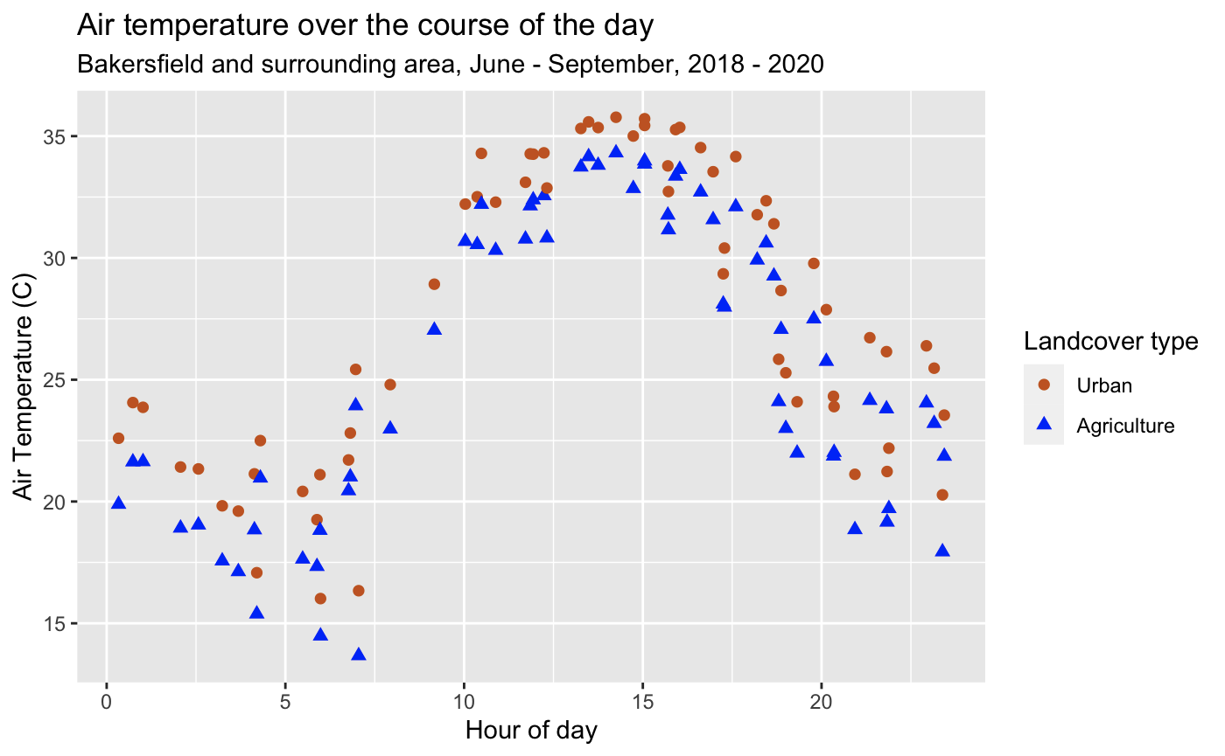
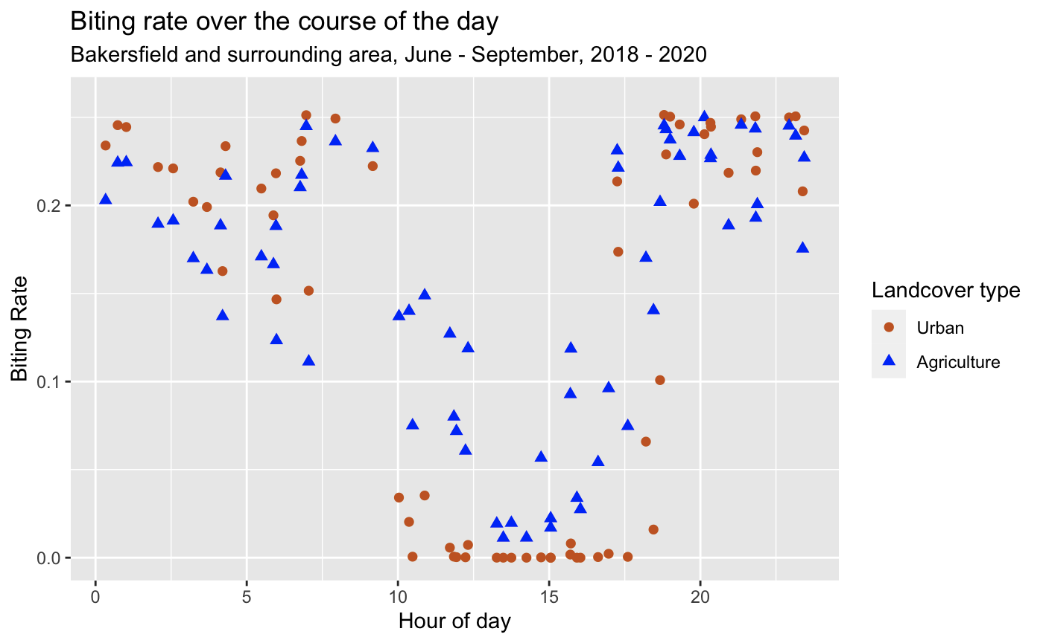
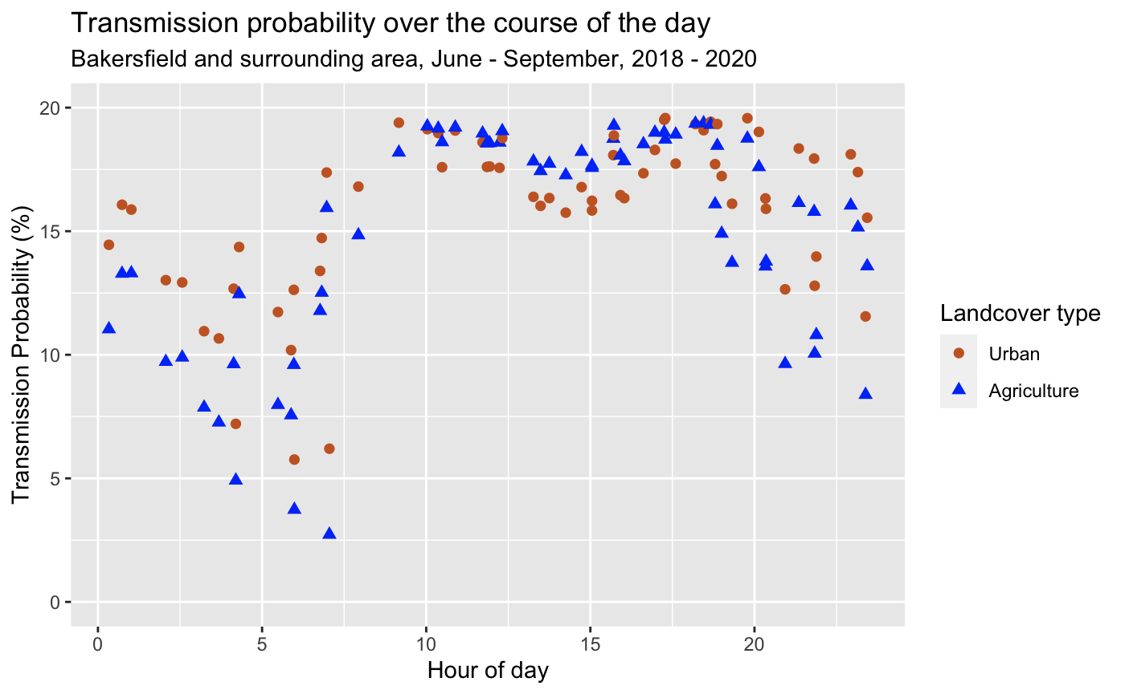
Spatio-temporal variation
Air temperature (C)
Introduction
Conclusion
Methods
Analysis
Biting rate
Transmission probability

Slide 5
Conclusion
We can see spatio-temporal variations of WNV risk at new resolutions
Such information can be used to better target WNV mitigation and prediction
Introduction
Conclusion
Methods
Analysis

